Slide 1
FLS Unit 3
DS 6371
Johnny Vogt

Slide 2
Quick Questions
d.
A, b,c
A. True
C

Slide 3
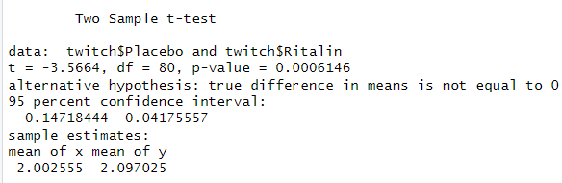
Question 2
Null and Alternative Hypothesis
  H0: μ_{placebo} – μ_{ritalin} = 0 Ha: μ_{placebo} – μ_{ritalin} ≠ 0
Critical Values: (-.147, -.0417), a = .05
  95% Confidence Level
T-Value: -3.56674
P-Value: .0006146
Reject H0
At a 95% confidence level, it clear that we should reject the Null Hypothesis that states the mean reaction times between the placebo group and Ritalin Group are equal. A P-Value of .006146, shows the extreme unlikeliness of the difference of sample means reaching this result, further encouraging the result

Slide 4
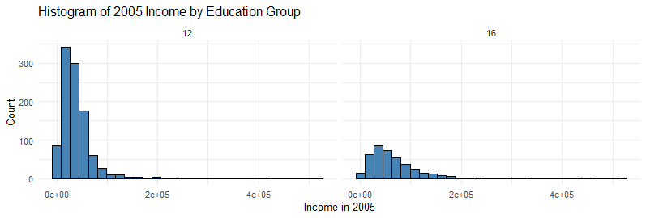
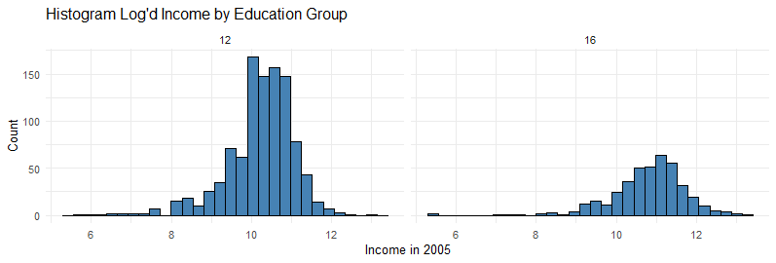
Question 3
Test the claim that people who have 16 years of education make more money than people who have only 12 years of education
  H0: μ₁₆ – μ₁₂ = 0 or Ha: μ₁₆ – μ₁₂ ≠ 0
The assumption (Not the null) is that the people in the right histogram makes more than the people on the left.
We’re going to log the income data because both sets of data are right skewed AND the sample sizes are not even close to each other and log transforming will help normalize the data closer to each other. Log Transformed Data shown on the graph on the right below. We are also going to be running a welch’s test because the sample sizes are not close.

Slide 5
Question 3 Cont.
H0: μ₁₆ – μ₁₂ = 0 or Ha: μ₁₆ – μ₁₂ ≠ 0
Critical Value (-.6769843, -.4627577), a = .5
T Value: -10.446 (Wow)
Pvalue: < 2.2e-16 (Jeez)
Reject H0
Assuming the null hypothesis is true and a significance value of .5. Our 95% confidence Interval being (-.68 - -.46) being centered on the sample difference, showed that an instance of the difference being 0 is outside of our Confidence Interval. The P value of our current sample is <2.2e-16, meaning we are EXTREMELY unlikely to see difference in (log-transformed) income means, if we were to run this study again. This is why we should reject the null hypothesis, where the log transformed income means between 12 and 16 years are equal.
This is an observational study, where there was no randomized sample. In fact the subjects were only people that were a part of the NLSY79 population AND had paying jobs. This limitation would have the potential the change the data and couldn’t be generalized to the larger population, since they were not randomized and the possible subjects of the true population did not have an equal opportunity to join the study. We are unable to make any causal references, but we should be able to use the data for direction for further studies.

Slide 6
Code
library(readr)EducationData <- read_csv("C:/Users/jvogt/Desktop/School/SMU/MSDS_6371_Stat_Foundations/Unit 3/EducationData.csv")View(EducationData)
ggplot(EducationData, aes(x = Income2005)) +
geom_histogram(fill = "steelblue", color = "black") +
facet_wrap(~ Educ, nrow = 1) +
labs( title = "Histogram of 2005 Income by Education Group", x = "Income in 2005", y = "Count" ) + theme_minimal()
EducationData$log_Income2005 <- log(EducationData$Income2005)EducationData
ggplot(EducationData, aes(x = log_Income2005)) +
geom_histogram(fill = "steelblue", color = "black") +
facet_wrap(~ Educ, nrow = 1) +
labs( title = "Histogram Log'd Income by Education Group", x = "Income in 2005", y = "Count" ) +
theme_minimal()
t.test(EducationData$log_Income2005 ~ EducationData$Educ, var.equal = TRUE)

Slide 7
Takeaways
I log’d AND ran a welch’s test, but I’m not sure if I was supposed to do it, but it seemed right.
I need more practice (and time), doesn’t seem difficult but I need to keep going back and re-reading/googlin things that I should know already
  Specifically that the Confidence Interval was centered on the difference of the sample mean and THAT was the point. That the 0 was SO far away. Definitley should’ve already known that
More Hypothesis tests. At least I can remember the six steps now lol
Also I asked about Welch’s test back in Week 2 or 3 in DDS, and It’s all coming full circle (ﾉ◕ヮ◕)ﾉ*:･ﾟ✧

